Slide 1

READIFY Smart Digital Book Reader System
Submitted by:
Yashaswi Anil Rao Yashwanth Raj KS
1RVU23BSC177 1RVU23BSC180

Slide 2
Abstract
Readify is a smart digital book reader that lets users read books online, rate and review them, and track their reading history. It provides an interactive PDF reading experience with community feedback features and secure authentication.
Key Features:
User login & signup
PDF reader integration
Book rating & review
Reading history tracking

Slide 3
Objectives
Provide smooth digital reading access
Maintain user reading history
Allow ratings and reviews
Build a community-driven feedback system
Secure backend APIs for user data

Slide 4
Existing vs Proposed System
Existing System
Proposed System (Readify)
No unified platform
No rating/review option
No reading history
Limited engagement
Single web-based platform
Allows rating & reviewing
Tracks user activity
Interactive UI with feedback

Slide 5
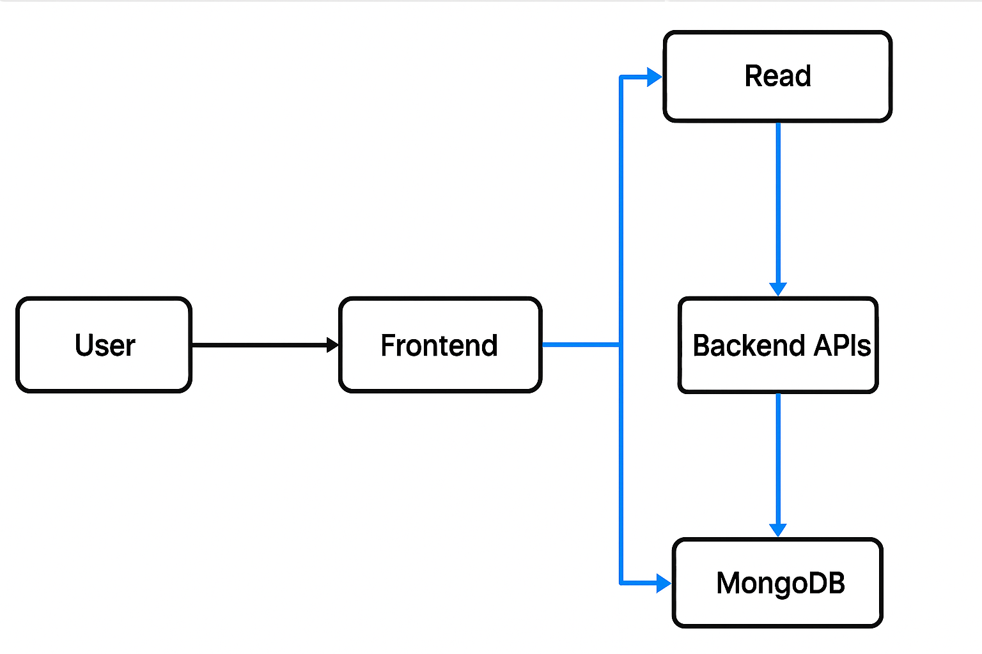
System Architecture
Frontend
Backend
Mongo DB
User
Web App
Express API
Mongo DB

Slide 6
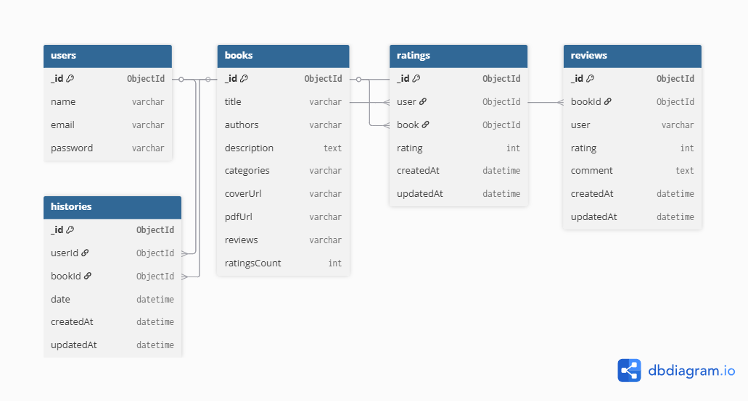
Schema Diagram

Slide 7
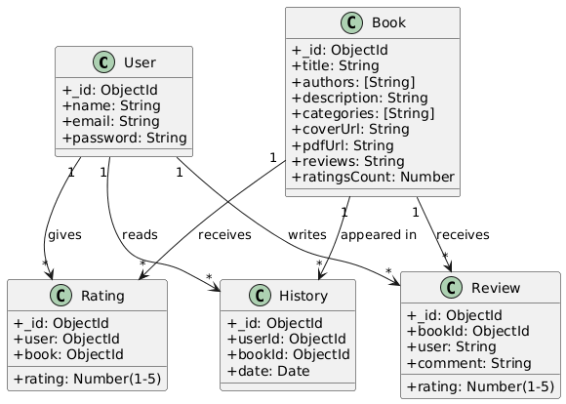
UML Diagram

Slide 8
Modules
Authentication
Dashboard
Book Reader
History
System
Rating System
Review System

Slide 9
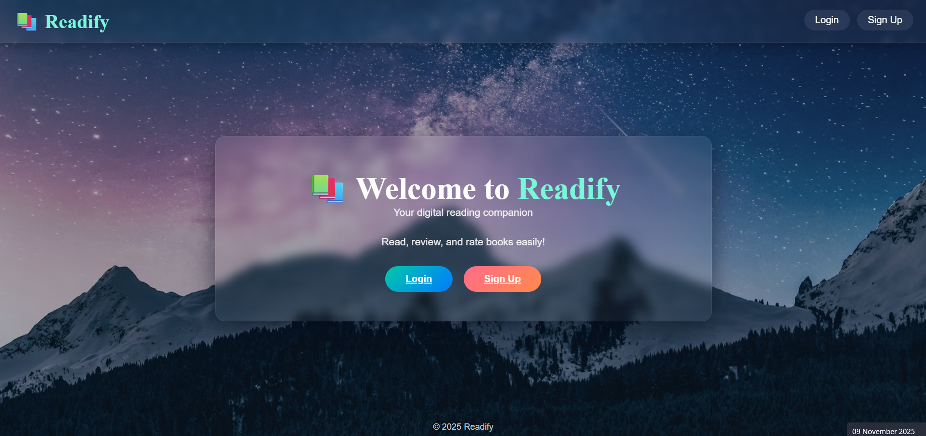

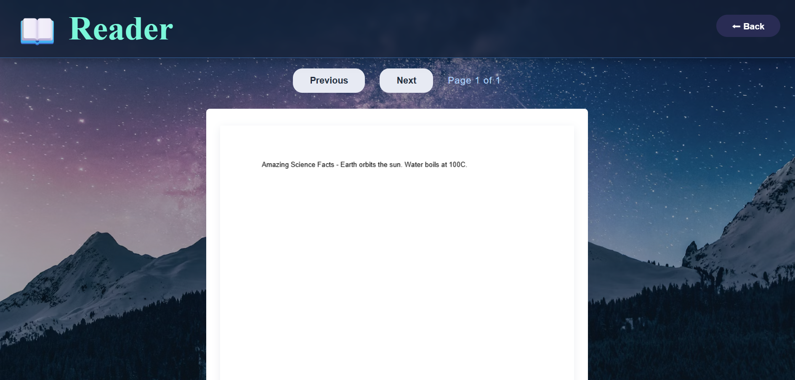
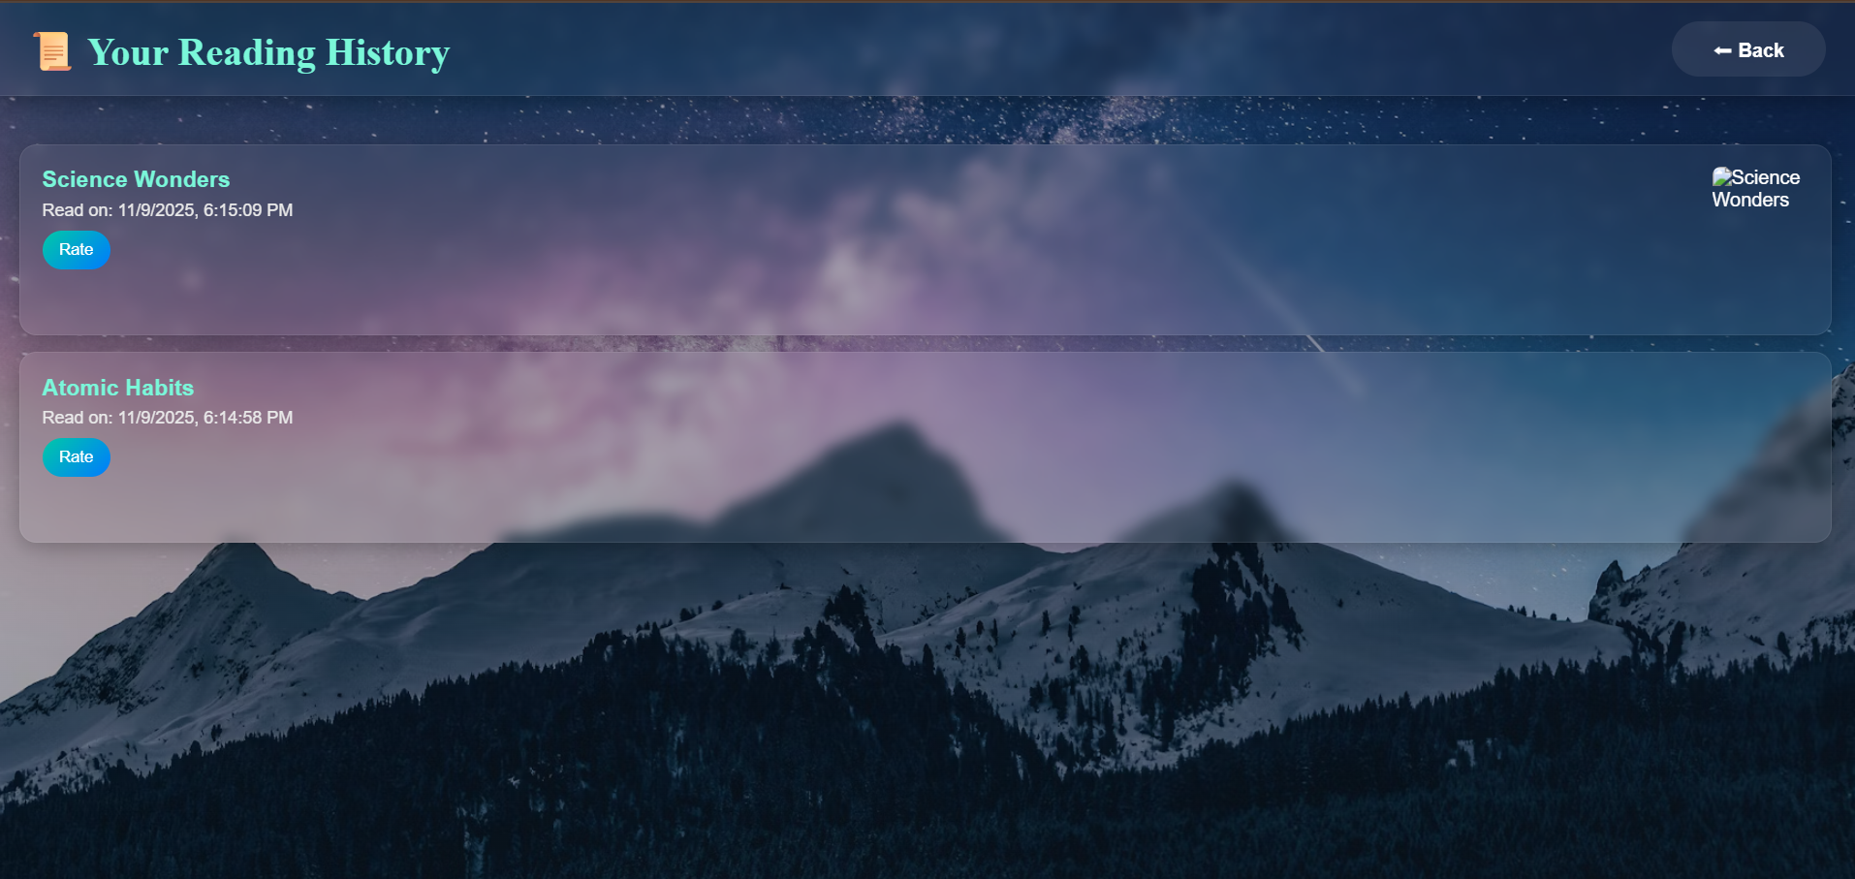
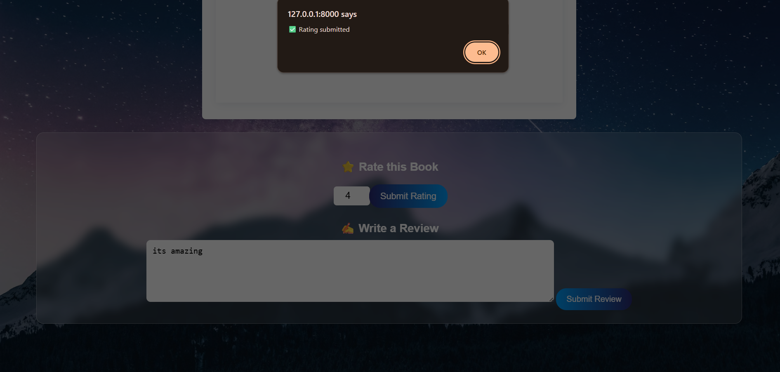
Output Screenshots

Slide 10
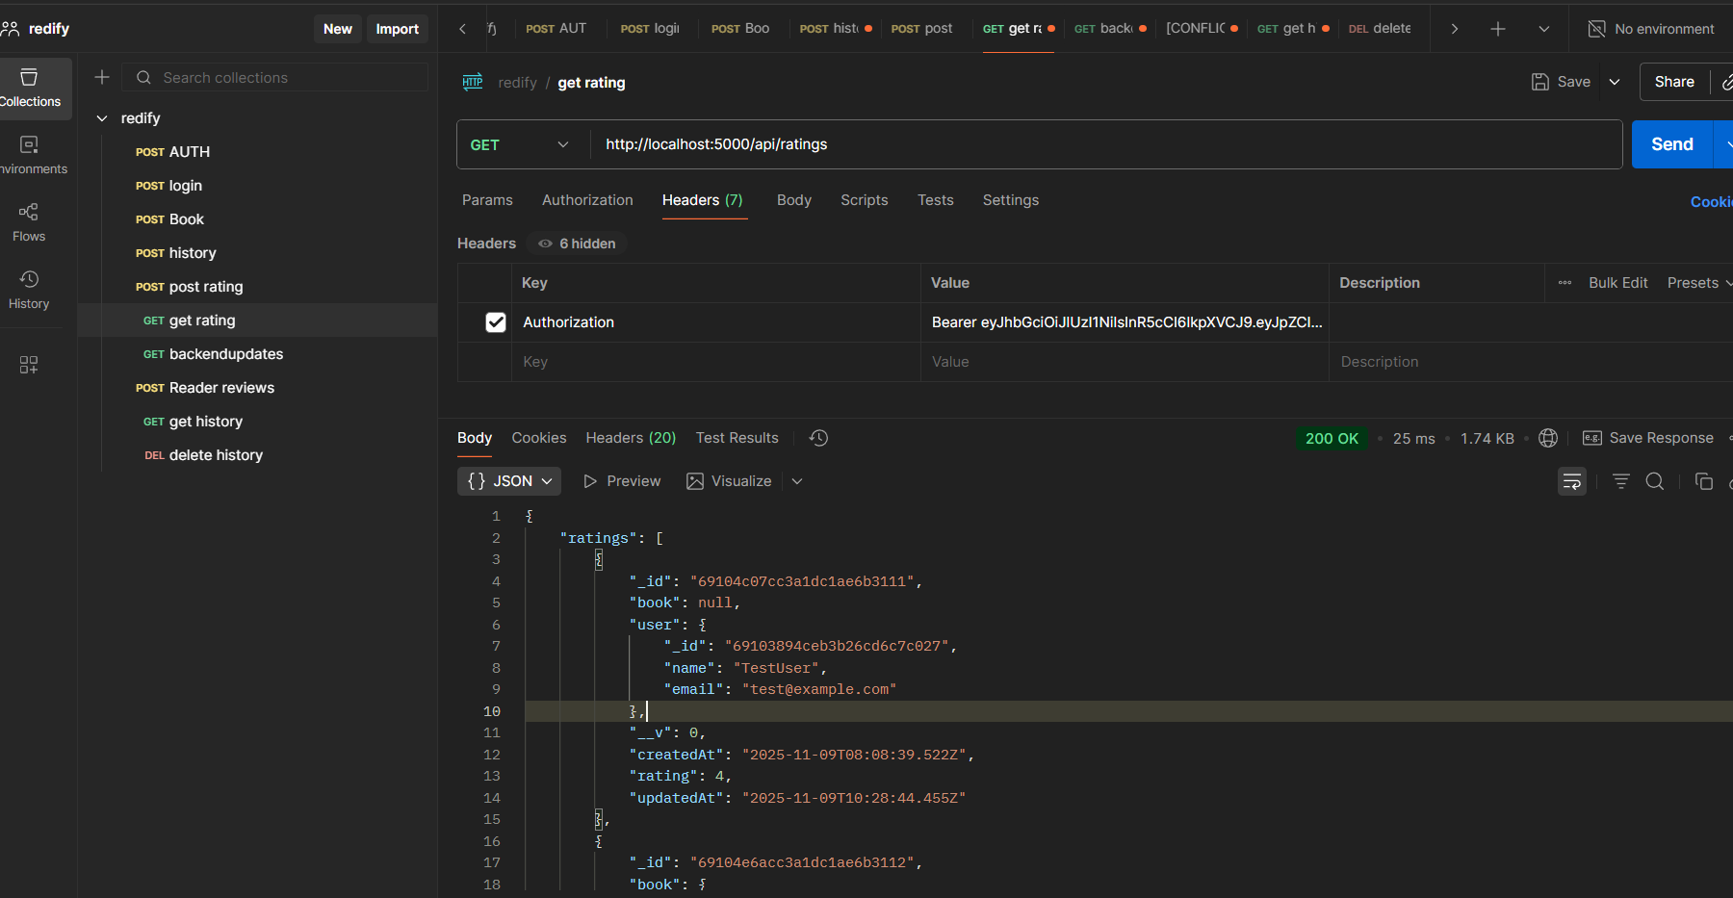
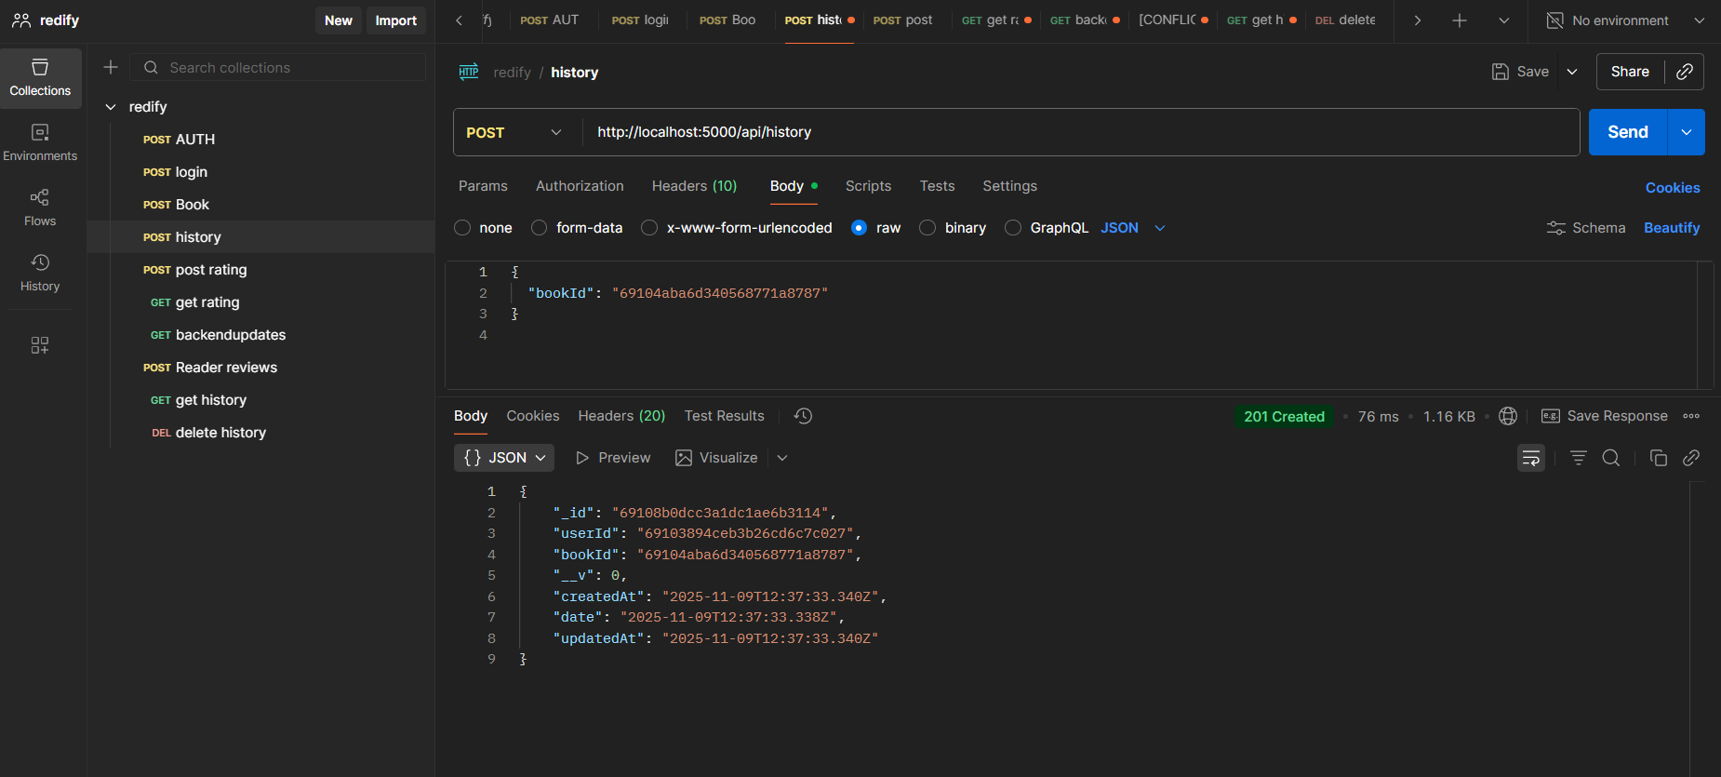
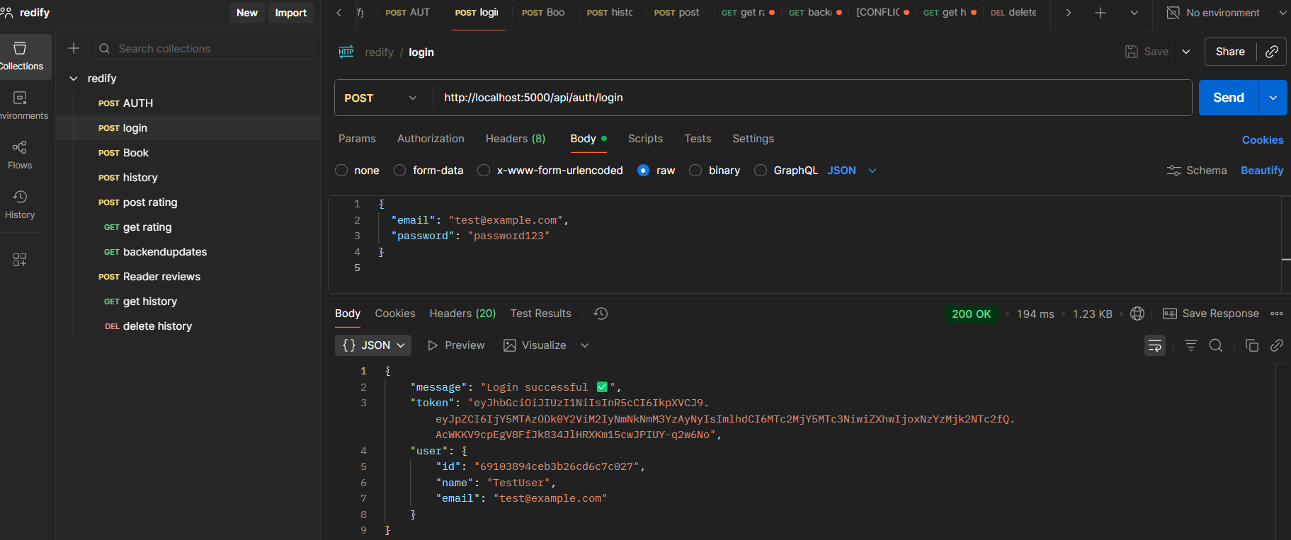
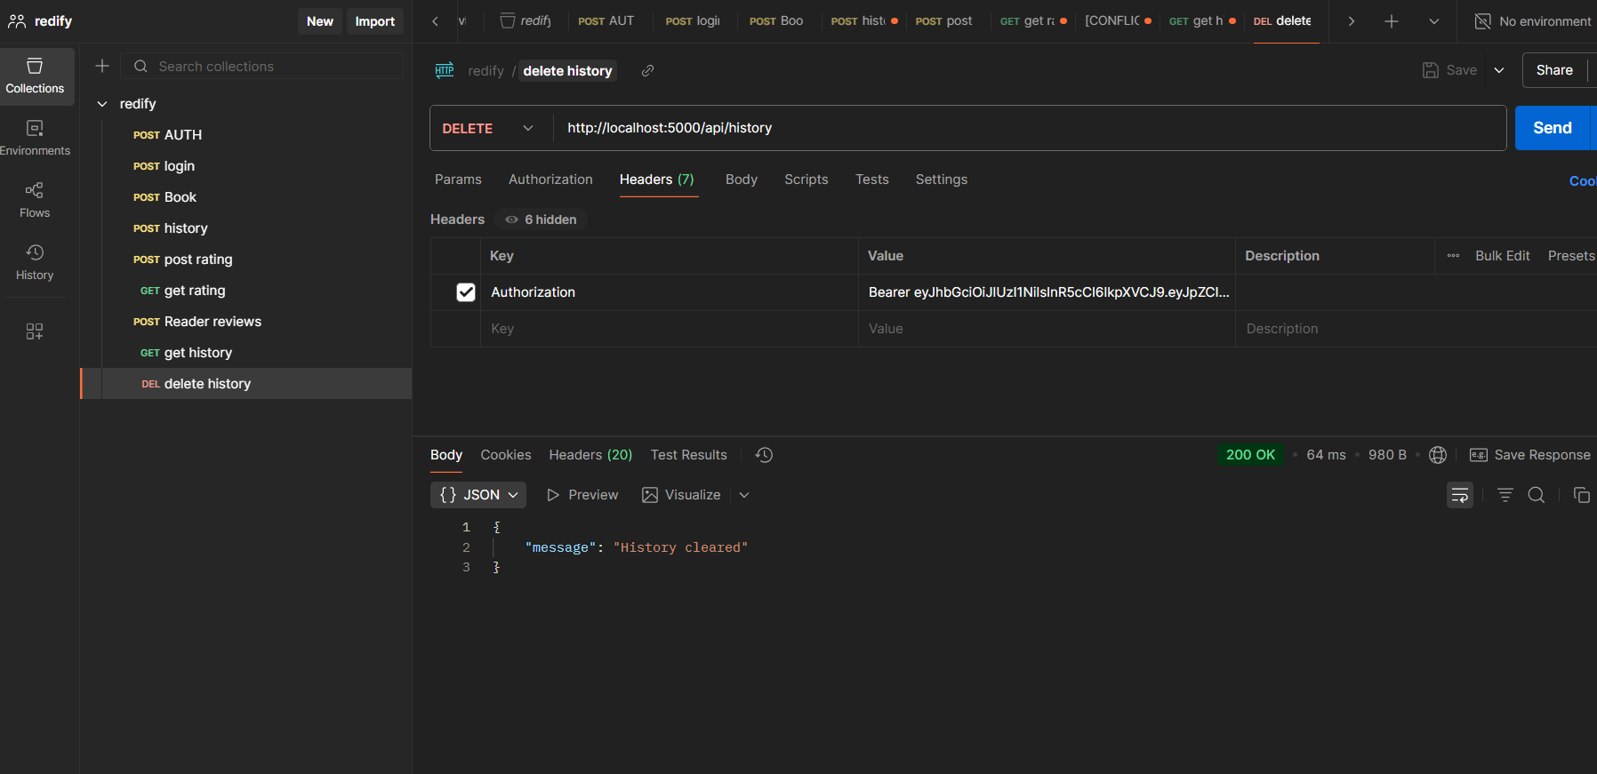
Postman Screenshots

Slide 11
Results
✔ Functional Online Reader ✔ Secure Authentication ✔ Reading History Maintained ✔ Reviews Displayed in Real-Time

Slide 12
Future Enhancements
AI Based Book Recommendations
Admin Panel
Cloud Hosting
Bookmarks and Notes
Social Sharing

Slide 13
Thank You

